Slide 1


Generating Renewable Energy From Footsteps
- Geetika Sood (Data Analyst)

Slide 2


Renewable energy
2022
Energy generated from sources that are naturally replenished
We’re currently reliant on nature to generate renewable energy
Why Renewable:
Cleaner greener economy and society
Step towards a sustainable future
Ireland’s share of renewable sources in total electricity generation in 2022 at 43%, up by 4% from 2020
+4%
2020
Notes:
Renewable energy is energy produced from sources like the sun and wind that are naturally replenished and do not run out. Renewable energy can be used for electricity generation, space and water heating and cooling, and transportation.
protect us from the devastating consequences of climate change

Slide 3
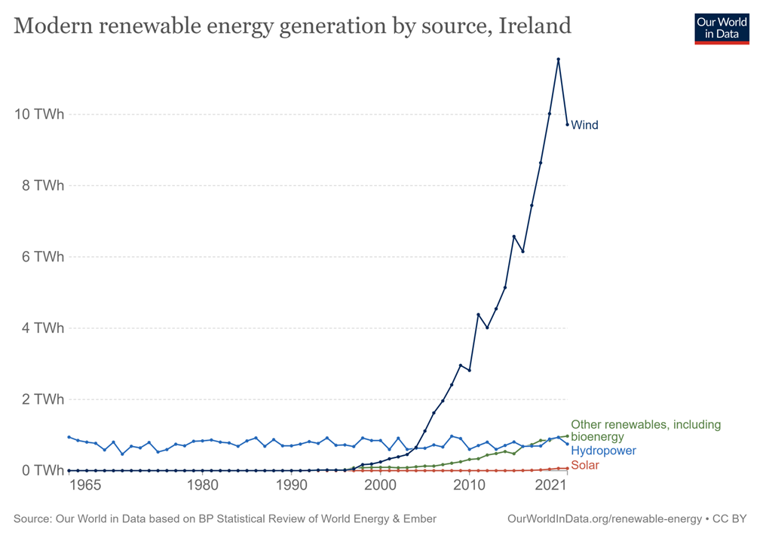
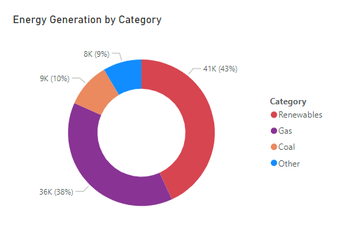
Renewable energy: Ireland
Renewable Energy 1965-2021
Source: Our world in Data
Energy Generation 2022
Source: EIR Grid Group
Notes:
Next: All other sources are dependent on Nature again, however human contribution is missing
﻿Renewables had the highest Energy at 40731, followed by Gas, Coal, and Other.﻿﻿ ﻿﻿ ﻿﻿Renewables accounted for 43.19% of Energy.﻿﻿ ﻿﻿ ﻿

Slide 4
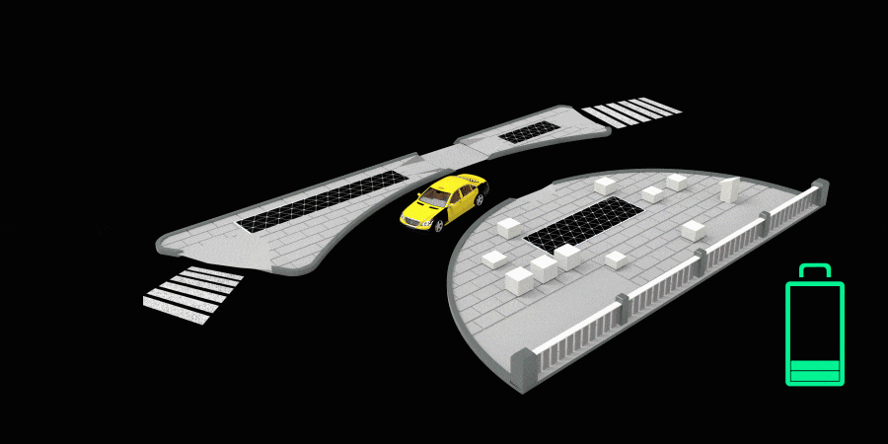
Walk to Generate Energy
Pavegen, a UK-based company’s product consists of:
Electro-Magnetic Generator
Singular composite tile
People
They claim to generate 3-6 Joules of energy per footstep.
Notes:
﻿ ﻿﻿ ﻿﻿Across all metrics, Newcomen Bridge/Charleville mall inbound had the most interesting recent trend and started trending up on Saturday, February 5, 2022, rising by 4.76% (3222) in 14 days.﻿﻿ ﻿﻿ ﻿﻿[]﻿﻿ ﻿﻿ ﻿﻿Talbot st/Murrays Pharmacy jumped from 0 to 1 during its steepest incline between Friday, February 4, 2022 and Wednesday, February 9, 2022.﻿﻿ ﻿﻿ ﻿
Improve the generation of renewable energy

Slide 5
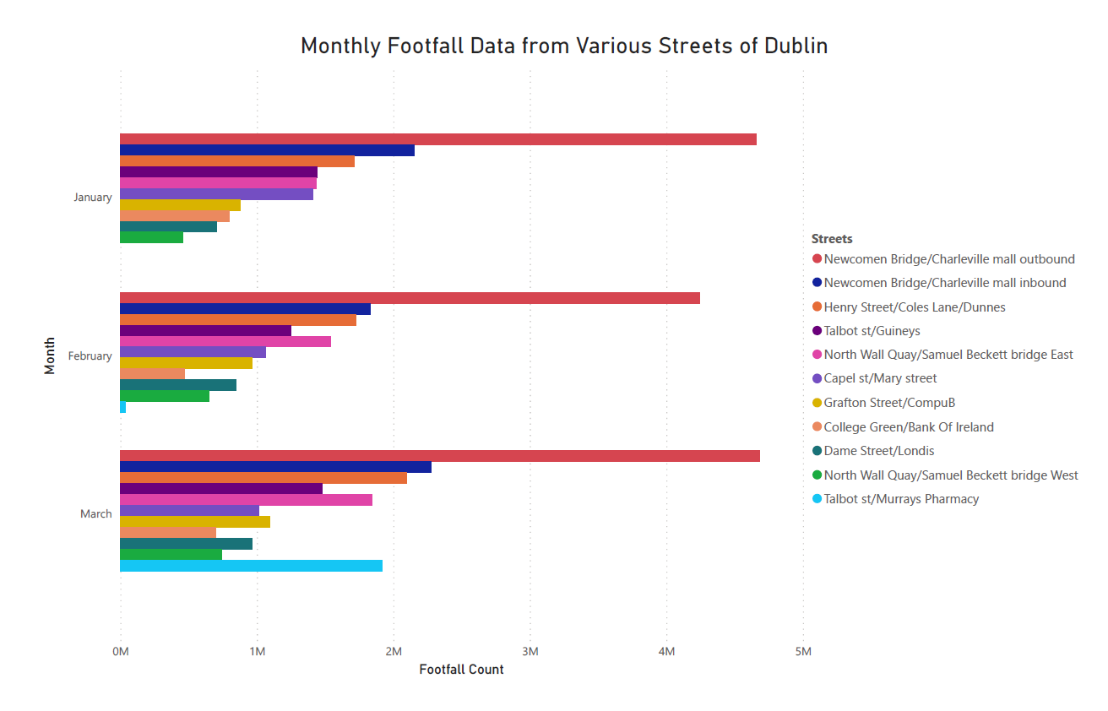

Slide 6
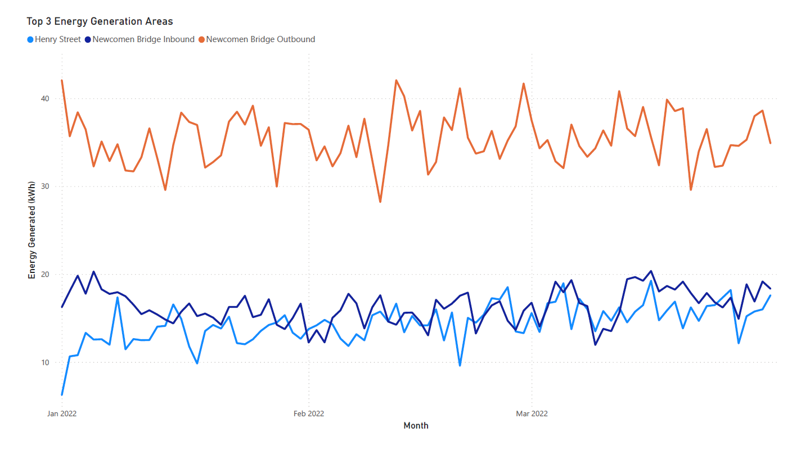
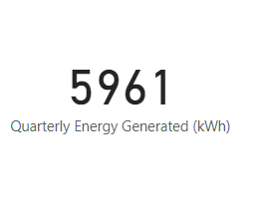
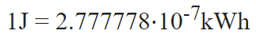
Notes:
﻿Between Saturday, January 1, 2022 and Thursday, March 31, 2022, Henry Street had the largest increase (181.90%) while Newcomen Bridge Outbound had the largest decrease (17.08%).﻿﻿ ﻿﻿ ﻿﻿Newcomen Bridge Inbound started trending up on Saturday, March 12, 2022, rising by 17.28% (2.69) in 7 days.﻿﻿ ﻿﻿ ﻿﻿[]﻿﻿ ﻿﻿ ﻿﻿Newcomen Bridge Outbound dropped from 42.06 to 36.59 during its steepest decline between Saturday, January 1, 2022 and Wednesday, January 12, 2022.﻿﻿ ﻿﻿ ﻿

Slide 7
Here’s what 1 kilowatt-hour will get you:
10 minutes in an electric shower or one cycle of your washing machine or dishwasher.
About 30 mins of tumble drying or cooking with one large ring will also use up about one kWh each.
Half an hour of kettle use.
About 6 hours of TV-watching or desktop computer use.

Slide 8
Let’s walk to a better world. -Thank you

